Slide 1
Chapter 12: Applications: Legal Psychology

Slide 2
Applications of Memory Research to Legal Psychology
Cost of misidentification: What happens if someone is falsely identified as perpetrating a crime?
Contributions of psychology to the legal system
  Witnesses rely on memory
  Eyewitness memory is usually considered strong evidence
  Interrogation also relies on psych research
Research on memory can inform legal decision making!
Notes:
Satisfies Learning Objective 1: Understand how memory research can affect legal psychology and impact the legal system.
Cost of misidentification: This can prove to be enormous both in lost time for an innocent falsely accused and in the cost of a child-murderer and rapist not being put away.
Contributions of psychology:
Many aspects of the legal system reflect important psychological processes.
Witnesses to crimes must rely on memory to help police with their investigations.
Interrogation of criminal suspects also depends heavily on psychological research.
Cognitive and social processes: Research on human memory processes can inform decision-making within a legal context.

Slide 3
Eyewitness Memory (1 of 6)
How reliable is eyewitness memory?
Is eyewitness memory alone enough to convict someone of a crime?
Notes:
Satisfies Learning Objective 2: Describe what suggestibility is and how it is a factor in the misinformation effect.
Misremember information: Our memories readily incorporate information from other sources into our original memory of an event.
Suggestibility: The tendency to incorporate information from sources other than the original witnessed event, such as other people, written materials, or pictures, which may be misleading.

Slide 4
Eyewitness Memory (2 of 6)
Misremember information: Our memories readily incorporate information from other sources into our original memory of an event
Suggestibility: The tendency to incorporate other information
  Examples: People, pictures, written materials
  Anything that could be misleading
Notes:
Satisfies Learning Objective 2: Describe what suggestibility is and how it is a factor in the misinformation effect.
Misremember information: Our memories readily incorporate information from other sources into our original memory of an event.
Suggestibility: The tendency to incorporate information from sources other than the original witnessed event, such as other people, written materials, or pictures, which may be misleading.

Slide 5
Eyewitness Memory (3 of 6)
Theory of suggestibility proposes that people assume certain “given” information, especially when coming from authority figures
  Incorporate information from leading questions!
  Influences memory!
Notes:
Satisfies Learning Objective 2: Describe what suggestibility is and how it is a factor in the misinformation effect.
Incorporate information from leading questions:
The theory of suggestibility shows how people assume certain “given” information in questions, particularly when they come from authority figures.
This information can subtly influence the nature of the witness’s memory.
Demonstration by Loftus and Palmer:
In a classic experiment on eyewitness memory, participants were asked to watch a short film depicting a motor vehicle accident.
Based on this, five questions were put forth:
How fast were the cars going when they smashed into each other?
How fast were the cars going when they collided with each other?
How fast were the cars going when they bumped each other?
How fast were the cars going when they hit each other?
How fast were the cars going when they contacted each other?
The results revealed how people’s memory was affected by a subtle difference in wording, so much so that their report of the accident became biased.
In fact, the simple change from an indefinite article to a definite article raised the rate of false memory from 7% to 18%.

Slide 6
Eyewitness Memory (4 of 6)
Loftus and Palmer (1974): Participants watched a short film showing a car accident
Participants asked to identify speed of vehicles
Five conditions that modified the wording
  Smashed, Collided, Bumped, Hit, or Contacted
Notes:
Demonstration by Loftus and Palmer:
In a classic experiment on eyewitness memory, participants were asked to watch a short film depicting a motor vehicle accident.
Based on this, five questions were put forth:
How fast were the cars going when they smashed into each other?
How fast were the cars going when they collided with each other?
How fast were the cars going when they bumped each other?
How fast were the cars going when they hit each other?
How fast were the cars going when they contacted each other?
The results revealed how people’s memory was affected by a subtle difference in wording, so much so that their report of the accident became biased.
In fact, the simple change from an indefinite article to a definite article raised the rate of false memory from 7% to 18%.

Slide 7
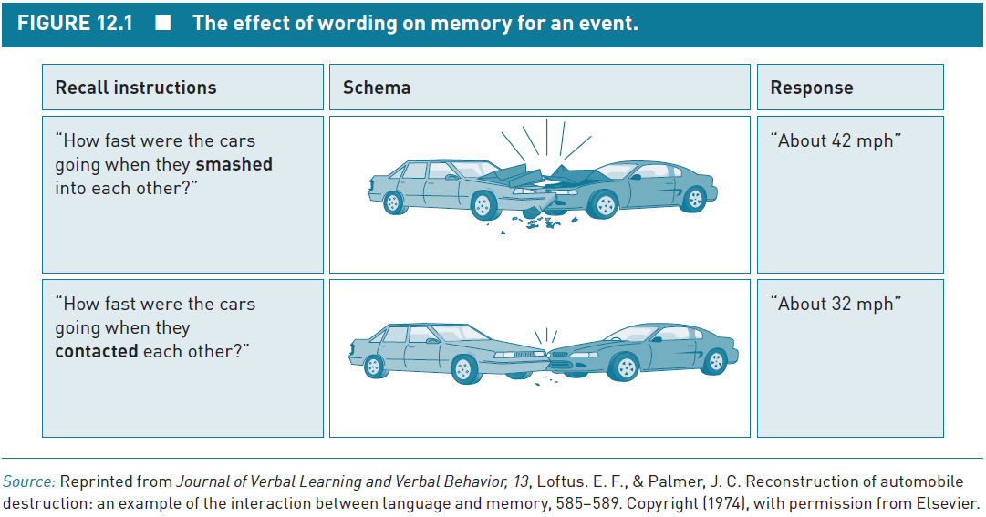
Eyewitness Memory (5 of 6)
Notes:
Satisfies Learning Objective 2: Describe what suggestibility is and how it is a factor in the misinformation effect.
Figure 12.1: Stimulus for Loftus and Palmer (1974).

Slide 8
Eyewitness Memory (6 of 6)
Verb Used | Estimated Speed
Smashed | 41
Collided | 39
Bumped | 38
Hit | 34
Contacted | 32
Notes:
Satisfies Learning Objective 2: Describe what suggestibility is and how it is a factor in the misinformation effect.

Slide 9
The Misinformation Effect (1 of 11)
Misinformation effect: Presenting post-even misinformation about a witnessed event can change memory for the original event
Developed by Elizabeth Loftus
Notes:
Satisfies Learning Objective 2: Describe what suggestibility is and how it is a factor in the misinformation effect.
Misinformation effect:
Result of presenting postevent misinformation about a witnessed event that can obscure, change, or degrade the memory of the original event.
Developed by Elizabeth Loftus.
In her methodology, Loftus embedded in these descriptions some factual information (consistent with actual event) and some misleading information (contradictory to the actual event).
Experimental study by Cochran et al.:
The researchers combined the misinformation paradigm with a version of the altered memory paradigm in a study where they asked participants to watch a slide show depicting a crime.
The descriptions were altered by the researchers for a second viewing.
The majority of participants failed to detect the alteration in their own reports.
Many participants incorporated the misinformation into their memory report in a final memory test.

Slide 10
The Misinformation Effect (2 of 11)
Loftus, Miller, & Burns (1978): Participants watched a series of slides depicting a traffic accident
  Car A runs a stop sign and hits Car B
Two conditions:
  Consistent: How fast was Car A going when it passed the stop sign?
  Inconsistent: How fast was Car A going when it passed the yield sign?
Memory test: Did Car A go past a stop sign of yield sign?

Slide 11
The Misinformation Effect (3 of 11)
1. Witnesses view crime film.
2. Receive Condition 1 (some factual information) and/or Condition 2 (some misleading information).
3. Take memory test.
4. Performance on Condition 2 is worse than on Condition 1.
Notes:
Satisfies Learning Objective 2: Describe what suggestibility is and how it is a factor in the misinformation effect.

Slide 12
The Misinformation Effect (4 of 11)
Loftus et al. (1978) findings:
Group | Percent Correct
Consistent Information | 75%
Inconsistent Information | 41%

Slide 13
The Misinformation Effect (5 of 11)
Cochran et al. (2018): Altered the classic misinformation paradigm so that participants watched two viewings of a crime.
  Descriptions were altered in the second viewing
  Most participants failed to detect the alteration
  On a memory test, most participants incorporated the misinformation
Notes:
Experimental study by Cochran et al.:
The researchers combined the misinformation paradigm with a version of the altered memory paradigm in a study where they asked participants to watch a slide show depicting a crime.
The descriptions were altered by the researchers for a second viewing.
The majority of participants failed to detect the alteration in their own reports.
Many participants incorporated the misinformation into their memory report in a final memory test.

Slide 14
The Misinformation Effect (6 of 11)
A robust finding: The misinformation effect is easily found and often replicated
Found for both short and long retention intervals
Works on memory for people, objects, and background details
Notes:
A robust finding:
Easily found and easily replicated.
Works on memory of people or objects in an event, central or peripheral details of an event, with details that may or may not arouse emotion.
The effect can work at short- and long-retention intervals.
It works in both native and second languages, though the effect is more effective in the latter.
Study by Gordon et al.:
The researchers followed the presentation of a simulated crime, asking participants repeated questions about the event in an open-ended format without the presentation of misinformation.
Misinformation was introduced after the retrieval practice.
In the second scenario, the retrieval practice condition showed a larger misinformation effect.
In real-world situations, it implies that repeated questioning by the police can leave witnesses more susceptible to misleading questions later.
It can also be potentially damaging in the case of eyewitness memory.

Slide 15
The Misinformation Effect (7 of 11)
Gordon et al. (2012): Researchers showed participants a simulated crime then asked repeated, open-ended question about the event
Did not include misinformation during questioning phase
Participants took a practice test, then misinformation was introduced
Participants then took another test
Other condition did NO RETRIEVAL PRACTICE
Notes:
Study by Gordon et al.:
The researchers followed the presentation of a simulated crime, asking participants repeated questions about the event in an open-ended format without the presentation of misinformation.
Misinformation was introduced after the retrieval practice.
In the second scenario, the retrieval practice condition showed a larger misinformation effect.
In real-world situations, it implies that repeated questioning by the police can leave witnesses more susceptible to misleading questions later.
It can also be potentially damaging in the case of eyewitness memory.

Slide 16
The Misinformation Effect (8 of 11)
Gordon et al. (2012) Findings:
  The retrieval practice group had a greater misinformation effect vs no practice group
  Practical implications: Repeated questioning by police can leave witnesses more susceptible to late misleading questions
  Can potentially be damaging to eyewitness memory!
Notes:
Study by Gordon et al.:
The researchers followed the presentation of a simulated crime, asking participants repeated questions about the event in an open-ended format without the presentation of misinformation.
Misinformation was introduced after the retrieval practice.
In the second scenario, the retrieval practice condition showed a larger misinformation effect.
In real-world situations, it implies that repeated questioning by the police can leave witnesses more susceptible to misleading questions later.
It can also be potentially damaging in the case of eyewitness memory.

Slide 17
The Misinformation Effect (9 of 11)
Explanations for the Misinformation Effect
Trace impairment view: Original memory is altered by misinformation
Blending view: New memory is a blend of original memory for event and misinformation
Notes:
Satisfies Learning Objective 2: Describe what suggestibility is and how it is a factor in the misinformation effect.
Trace impairment view:
A theory that explains the misinformation effect.
The original memory is altered by the misinformation.
Also called the “blending” view as the new memory is a blending of the original event and the memory of the later information, including the misinformation.
Coexistence hypothesis:
A theory that explains the misinformation effect.
Participants form one memory about the original event and then form a second memory of reading questions or a summary after the event.
It is composed of both retrieved information from the first event and any new information derived from the postevent questions.
Test the hypotheses:
McCloskey and Zaragoza designed an experiment with a simple variation of the misinformation paradigm, that is the examination of the effect of the kind of incorrect distractors used on the recognition test.
The researchers, under their experimental design, found the coexistence view to be correct.
Evidence for the trace impairment view comes from research on blending.
Influence on suggestibility and false memory:
The contrast between the influence of the misinformation effect on these two theories is minor.
However, the representation is critical to understanding how memory works.
Altered representations or the presence of two separable memory traces have practical implications.

Slide 18
The Misinformation Effect (10 of 11)
Explanations for the Misinformation Effect
Coexistence hypothesis: Participants form one memory for original event and a second, separate memory for misinformation
Information from both events is retrieved at test
Notes:
Satisfies Learning Objective 2: Describe what suggestibility is and how it is a factor in the misinformation effect.
Trace impairment view:
A theory that explains the misinformation effect.
The original memory is altered by the misinformation.
Also called the “blending” view as the new memory is a blending of the original event and the memory of the later information, including the misinformation.
Coexistence hypothesis:
A theory that explains the misinformation effect.
Participants form one memory about the original event and then form a second memory of reading questions or a summary after the event.
It is composed of both retrieved information from the first event and any new information derived from the postevent questions.
Test the hypotheses:
McCloskey and Zaragoza designed an experiment with a simple variation of the misinformation paradigm, that is the examination of the effect of the kind of incorrect distractors used on the recognition test.
The researchers, under their experimental design, found the coexistence view to be correct.
Evidence for the trace impairment view comes from research on blending.
Influence on suggestibility and false memory:
The contrast between the influence of the misinformation effect on these two theories is minor.
However, the representation is critical to understanding how memory works.
Altered representations or the presence of two separable memory traces have practical implications.

Slide 19
The Misinformation Effect (11 of 11)
Testing the hypotheses: McCloskey and Zaragoza (1985) looked at the effects of misinformation on distractors on a recognition test
Findings supported a coexistence account
Notes:
Test the hypotheses:
McCloskey and Zaragoza designed an experiment with a simple variation of the misinformation paradigm, that is the examination of the effect of the kind of incorrect distractors used on the recognition test.
The researchers, under their experimental design, found the coexistence view to be correct.
Evidence for the trace impairment view comes from research on blending.
Influence on suggestibility and false memory:
The contrast between the influence of the misinformation effect on these two theories is minor.
However, the representation is critical to understanding how memory works.
Altered representations or the presence of two separable memory traces have practical implications.

Slide 20


Slide 21
Children’s Eyewitness Memory (1 of 6)
Highly suggestible.
In some cases, having children just think about the past is enough to induce false memories
Study by Leichtman and Ceci (1995)
  Children (ages 3-6) reported memories for a “strange man’s visit”
Notes:
Satisfies Learning Objective 2: Describe what suggestibility is and how it is a factor in the misinformation effect.
Highly suggestible:
Research suggests that young children are highly suggestible and prone to false memories.
This can make prosecuting people accused of harming children quite difficult.
High-profile criminal trials of the 1980s:
These put the issue of children’s eyewitness memory into the spotlight.
Since then, developmental psychologists have tried to examine the nature of the child as a witness.
Study by Leichtman and Ceci:
The researchers tried to investigate the suggestibility of child witnesses.
The false memory rate in the control condition was practically zero.
In the stereotype condition, however, the false memory rate increased to about 20% for younger children and about 10% for older children in the study.
The false memory rate was even higher in the suggestibility condition.
In some cases, even asking children to think about a past event is enough to increase false memories.

Slide 22
Children’s Eyewitness Memory (2 of 6)
Four Groups
  Control: No suggestive questions
  Stereotype: Previsit expectations
  Suggestion: Interviews contained suggestions about misdeads
  Stereotype + suggestion: Combination of groups 2 and 3
Notes:
Satisfies Learning Objective 2: Describe what suggestibility is and how it is a factor in the misinformation effect.
Highly suggestible:
Research suggests that young children are highly suggestible and prone to false memories.
This can make prosecuting people accused of harming children quite difficult.
High-profile criminal trials of the 1980s:
These put the issue of children’s eyewitness memory into the spotlight.
Since then, developmental psychologists have tried to examine the nature of the child as a witness.
Study by Leichtman and Ceci:
The researchers tried to investigate the suggestibility of child witnesses.
The false memory rate in the control condition was practically zero.
In the stereotype condition, however, the false memory rate increased to about 20% for younger children and about 10% for older children in the study.
The false memory rate was even higher in the suggestibility condition.
In some cases, even asking children to think about a past event is enough to increase false memories.

Slide 23
Children’s Eyewitness Memory (3 of 6)
Children’s memory was tested 10 weeks later
Findings:
  Control group: Highly accurate
  Stereotype: modest number of false reports
  Suggestion: Higher false reports
  Stereotype + suggestion: Highest number of false reports
Notes:
Satisfies Learning Objective 2: Describe what suggestibility is and how it is a factor in the misinformation effect.
Highly suggestible:
Research suggests that young children are highly suggestible and prone to false memories.
This can make prosecuting people accused of harming children quite difficult.
High-profile criminal trials of the 1980s:
These put the issue of children’s eyewitness memory into the spotlight.
Since then, developmental psychologists have tried to examine the nature of the child as a witness.
Study by Leichtman and Ceci:
The researchers tried to investigate the suggestibility of child witnesses.
The false memory rate in the control condition was practically zero.
In the stereotype condition, however, the false memory rate increased to about 20% for younger children and about 10% for older children in the study.
The false memory rate was even higher in the suggestibility condition.
In some cases, even asking children to think about a past event is enough to increase false memories.

Slide 24
Children’s Eyewitness Memory (4 of 6)
Memory and Stress in Children’s Episodic Memory
Important to understand, but difficult to research.
Studies often focus on memory for real-life trauma
  Potential problems with this approach?
Notes:
Satisfies Learning Objective 2: Describe what suggestibility is and how it is a factor in the misinformation effect.
Effect of stress on memory:
This is important to understand, especially in the context of children’s eyewitness memory.
However, it is unethical to put children into a stressful situation in order to study its effect on them.
Examination of memory for real-life trauma:
Studies focused on this can include tests for memory of painful but necessary medical procedures, of natural disasters, and of witnessing a real crime.
However, it is difficult to control the stress levels in these studies.
Although children are able to recall these stressful events, their effects on memory are not clear.
Study by Fivush et al.:
The researchers examined the memories of over 100 three- to four-year-old children who had experienced Hurricane Andrew, a Category 5 storm that ripped through Miami, in 1992.
The sample was divided into children who had experienced low, medium, and high stress, indicated by the amount of damage sustained to the child’s home.
The results revealed that the high stress caused by extensive damage may have interfered with children’s ability to accurately encode events.
The best memory performance was seen in the moderate-stress condition.
Evidence from other studies:
Many studies have attempted to examine the effects of stress, especially those associated with being a witness to or victim of a crime.
In this context, many argue that children’s memory is reliable and can be trusted.
However, the available data in this regard suggest that:
Children are at greater risk of false memories than adults.
High-stress situations can increase that risk while lowering the amount of veridical recall.

Slide 25
Children’s Eyewitness Memory (5 of 6)
Fivush et al. (2004): Examined memories of over 100 3- and 4-year-olds who experienced Hurricane Andrew
Children were dived by stress level, based on how badly their homes were damaged
Moderate stress children had best memory performance
Notes:
Study by Fivush et al.:
The researchers examined the memories of over 100 three- to four-year-old children who had experienced Hurricane Andrew, a Category 5 storm that ripped through Miami, in 1992.
The sample was divided into children who had experienced low, medium, and high stress, indicated by the amount of damage sustained to the child’s home.
The results revealed that the high stress caused by extensive damage may have interfered with children’s ability to accurately encode events.
The best memory performance was seen in the moderate-stress condition.
Evidence from other studies:
Many studies have attempted to examine the effects of stress, especially those associated with being a witness to or victim of a crime.
In this context, many argue that children’s memory is reliable and can be trusted.
However, the available data in this regard suggest that:
Children are at greater risk of false memories than adults.
High-stress situations can increase that risk while lowering the amount of veridical recall.

Slide 26
Children’s Eyewitness Memory (6 of 6)
Other note’s on children’s memory for events:
  Children are at greater risk for false memories than adults
  High-stress situations increase this risk while also lowering true (veridical) recall
Notes:
Evidence from other studies:
Many studies have attempted to examine the effects of stress, especially those associated with being a witness to or victim of a crime.
In this context, many argue that children’s memory is reliable and can be trusted.
However, the available data in this regard suggest that:
Children are at greater risk of false memories than adults.
High-stress situations can increase that risk while lowering the amount of veridical recall.

Slide 27
Older Adult’s Eyewitness Memory (1 of 5)
Suggestibility in Older Adults
More Susceptible to memory illusions!
  Misattribution of sources, DRM illusion, suggestive statements
Suggestibility is a major source of false memories in older adults!
Notes:
Susceptible to memory illusions: Older adults are more susceptible to a host of memory illusions caused by suggestive statements, misattribution of source, and associative meaning.
Influence of suggestibility and the misinformation effect:
Suggestibility is one of the major sources of false memories.
People are more likely to falsely remember the event if they have received misinformation.

Slide 28
Older Adult’s Eyewitness Memory (2 of 5)
Kerpel et al.: Older adults were more susceptible to the misinformation effect than younger adults
Exceptions: Older adults show less misinformation when there is a narrative to follow
Notes:
Studies on misinformation paradigm: Kerpel et al., in their study involving older and younger participants, were able to show how the older adults were more likely to misremember.
Exceptions to the rule:
In some situations, when there is a narrative to follow, older adults are actually less susceptible to misinformation effects than are younger adults.
Huff and Umanath, using two kinds of misinformation in their study, found that younger adults were more likely to show misinformation effects for contradictory misinformation than the older adults.

Slide 29
Older Adult’s Eyewitness Memory (3 of 5)
Types of Misinformation:
  Additive vs. Contradictory
Huff and Umanath (2018):
  Younger adults: More misinformation for contradictory information vs. older adults
Notes:
Studies on misinformation paradigm: Kerpel et al., in their study involving older and younger participants, were able to show how the older adults were more likely to misremember.
Exceptions to the rule:
In some situations, when there is a narrative to follow, older adults are actually less susceptible to misinformation effects than are younger adults.
Huff and Umanath, using two kinds of misinformation in their study, found that younger adults were more likely to show misinformation effects for contradictory misinformation than the older adults.

Slide 30
Older Adult’s Eyewitness Memory (4 of 5)
Misattribution of Source
Source memory: Remembering where information was learned from
Source-monitoring deficits:
  Widespread in older adults
  Worse under conditions of divided attention
Notes:
Satisfies Learning Objective 2: Describe what suggestibility is and how it is a factor in the misinformation effect.
Source memory: The ability of an individual to remember from whom or where (i.e., what source) he or she learned something.
Source-monitoring deficits:
These are widespread in older adults.
Divided attention can also lead older adults to make source errors.
Source errors do not extend to all kinds of tasks.
Negative consequences: For older adults, they must be especially vigilant to attend to source in order to avoid errors in daily tasks, such as, taking their pills.
Misidentifications in perceptions:
When older adults misperceive an object, they will often forget the correction that then leads them to correctly identify the object.
In contrast, younger adults, once corrected, remember the correct information.
Vannucci et al., in their experiment, discovered that false identifications of objects led to false memories in older adults, suggesting that they forget the source of the correct information.

Slide 31
Older Adult’s Eyewitness Memory (5 of 5)
Negative consequences?
Misidentifications in perceptions.
  Often forget the correction (later memory is still for the wrong source)
  Young adults tend to remember the corrected information
  Vannucci et al. (2014): False identification of objects lead to more false memories in older but not younger adults
Notes:
Satisfies Learning Objective 2: Describe what suggestibility is and how it is a factor in the misinformation effect.
.
Negative consequences: For older adults, they must be especially vigilant to attend to source in order to avoid errors in daily tasks, such as, taking their pills.
Misidentifications in perceptions:
When older adults misperceive an object, they will often forget the correction that then leads them to correctly identify the object.
In contrast, younger adults, once corrected, remember the correct information.
Vannucci et al., in their experiment, discovered that false identifications of objects led to false memories in older adults, suggesting that they forget the source of the correct information.

Slide 32
Simultaneous and Sequential Lineups in Eyewitness Memory (1 of 6)
People generally have good memory for faces, but verbal descriptions don’t reflect this
Test this using recognition memory
Notes:
Satisfies Learning Objective 3: Illustrate the differences between simultaneous and sequential lineups and the implications of the differences for police procedure.
Inadequacy of verbal descriptions:
Verbal descriptions do not reflect people’s good memory for faces.
As a result, researchers rely on recognition tests to measure face memory.
Simultaneous lineup (lineup):
A multiple-choice form of a face recognition test in which the participant sees several faces, including the one seen earlier.
The faces are usually matched on such features as gender, age, race, height and weight, the presence or absence of facial hair, and so on.
Sequential lineup (show-up):
An old-new form of a face recognition test in which the participant sees only one face and must decide if that face is one seen earlier.
The witness matches the particular face to his or her memory of the face.
Relative judgment: In a simultaneous lineup, participants may choose the face that most closely matches their memory of the target face.

Slide 33
Simultaneous and Sequential Lineups in Eyewitness Memory (2 of 6)
Simultaneous lineup: Multiple choice recognition test where the participant sees several faces. One face (usually) was seen earlier
  Relative judgment: Participants may choose the face that most closely matches memory, NOT the correct face
Notes:
Satisfies Learning Objective 3: Illustrate the differences between simultaneous and sequential lineups and the implications of the differences for police procedure.
lineup (lineup):
A multiple-choice form of a face recognition test in which the participant sees several faces, including the one seen earlier.
The faces are usually matched on such features as gender, age, race, height and weight, the presence or absence of facial hair, and so on.
Sequential lineup (show-up):
An old-new form of a face recognition test in which the participant sees only one face and must decide if that face is one seen earlier.
The witness matches the particular face to his or her memory of the face.
Relative judgment: In a simultaneous lineup, participants may choose the face that most closely matches their memory of the target face.

Slide 34
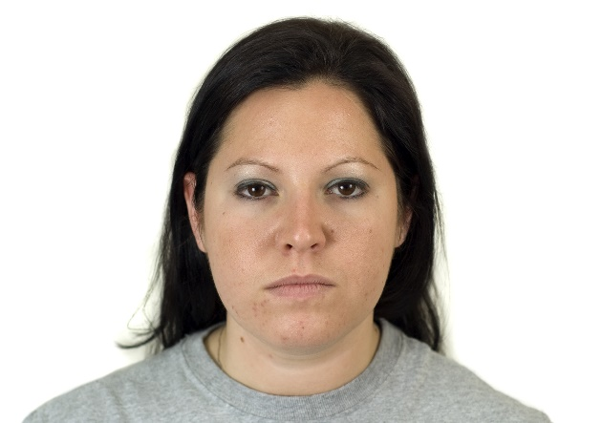
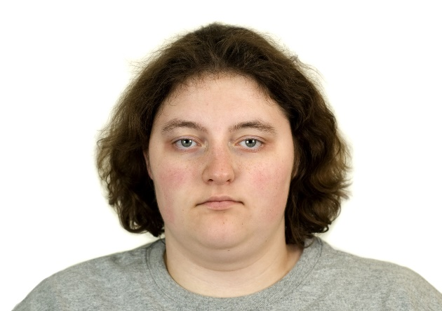
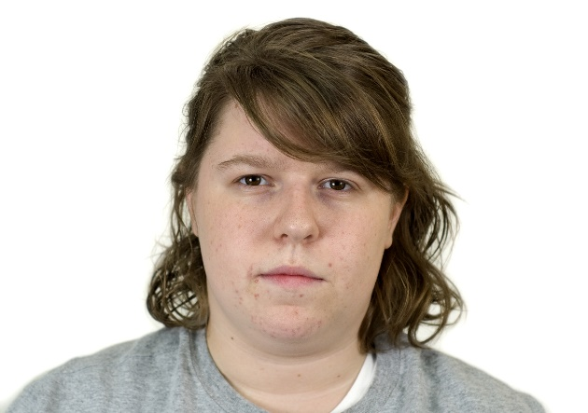
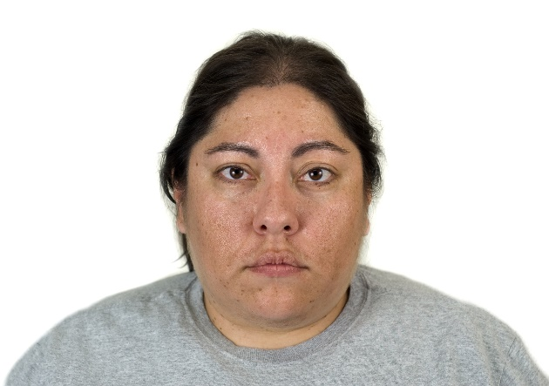
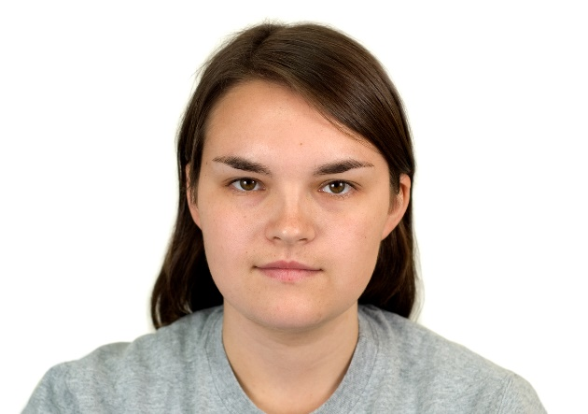
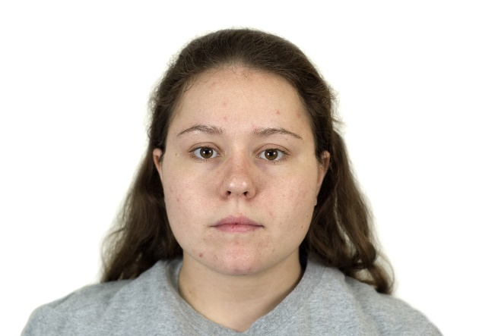
Notes:
Satisfies Learning Objective 3: Illustrate the differences between simultaneous and sequential lineups and the implications of the differences for police procedure.
lineup (lineup):
A multiple-choice form of a face recognition test in which the participant sees several faces, including the one seen earlier.
The faces are usually matched on such features as gender, age, race, height and weight, the presence or absence of facial hair, and so on.
Sequential lineup (show-up):
An old-new form of a face recognition test in which the participant sees only one face and must decide if that face is one seen earlier.
The witness matches the particular face to his or her memory of the face.
Relative judgment: In a simultaneous lineup, participants may choose the face that most closely matches their memory of the target face.

Slide 35
Simultaneous and Sequential Lineups in Eyewitness Memory (3 of 6)
Sequential lineup: Old-New recognition test
Faces presented one at a time
  Absolute judgment: Witness matches the face to their memory and decides if this particular face matches.

Slide 36
Simultaneous and Sequential Lineups in Eyewitness Memory (4 of 6)
Which type of line up is better?
Neuschatz et al. (2016): Simultaneous are better than sequential because its easier to reject distractors
Colloff and Wixted (2020): Presence of distractors was helpful for discriminating between criminals an innocents
Notes:
Test the hypotheses:
Neuschatz et al. believe that simultaneous lineups are better than sequential lineups for identifying suspects and rejecting distractors.
In a simultaneous lineup, participants can better identify traits of a face that are not consistent with the person they saw at the crime.
This fact has been borne out in the studies by Neuschatz et al. in which the simultaneous lineups show better accuracy both in terms of suspects identified and innocent people rejected.
In a large-scale comparative study with 3600 participants between simultaneous lineups and sequential lineups, Colloff and Wixted asked participants to correctly identify the criminals but correctly reject the innocent targets.
The researchers used three lineup conditions, that is, a sequential lineup, the traditional simultaneous lineup, and a simultaneous showup.
The observations from the study showed that the presence of distractors was helpful in discrimination of criminals from innocents.
Verbal overshadowing and verbal facilitation:
Verbal overshadowing: Hearing or giving a verbal description of a face makes remembering visual features more difficult.
Verbal facilitation: Hearing or giving a verbal description of a face makes remembering visual features easier.
Depending on test format, making a verbal description of a face will either facilitate or overshadow later memory performance.

Slide 37
Simultaneous and Sequential Lineups in Eyewitness Memory (5 of 6)
Own-Race Bias (Cross-race effect)
People are generally better at recognizing faces from their own race/ethnicity than other groups
Familiarity? Social categorization?
Cross-cultural finding
Notes:
Satisfies Learning Objective 3: Illustrate the differences between simultaneous and sequential lineups and the implications of the differences for police procedure.
Own-race bias: People are, by and large, better at recognizing faces from their own “race” than from other racial groups.
Evidence from data:
Suggests that nothing about the physical features of any particular ethnic group makes them more or less memorable.
Also, one group does not have a better memory than another.
Familiarity:
Experiences with different ethnic groups are necessary in order to identify the characteristics that distinguish faces in that ethnic group.
This idea finds support in studies by Chiroro et al. in which White South Africans performed equivalently to Black South Africans in the identification of Black faces.
The own-race bias seems to be a function of cross-cultural familiarity.

Slide 38
Simultaneous and Sequential Lineups in Eyewitness Memory (6 of 6)
Practical Implications of the Own-Race Bias?
  Eyewitness memory!
    False accusations (Case of Ronald Cotton)
Notes:
Satisfies Learning Objective 3: Illustrate the differences between simultaneous and sequential lineups and the implications of the differences for police procedure.
Natural and socially constructed features:
Socially constructed external features include hats, scarves, and jewelry.
This is supported in the study by Megreya et al. where Egyptian participants could accurately identify female faces when those women were wearing headscarves, whereas British participants were more accurate at identifying female faces when the women did not have their hair covered.
Overcome the bias:
A recent study by DeLozier and Rhodes suggests that this is possible.
The results of the study suggested that motivation to learn may help eliminate the own-race bias.
Practical implications:
This is especially relevant in eyewitness situations.
For example, if the witness comes from the majority group in a culture, he or she will be more accurate at identifying a suspect if the suspect is also from the majority racial or cultural group.

Slide 39
The Cognitive Interview: More Information without Suggestion
Cognitive interview: Designed to obtain the maximum amount of information w/out inducing false memories
Open-ended questions: Contain few cues, which allows individuals to describe memory without suggestion
Three retrieval-enhancing principles.
  Context restatement
  Different temporal patterns
  Mentally visualizing the crime scene from a variety of perspectives
Notes:
Cognitive interview:
A protocol designed to help police investigators obtain the maximum amount of information from witnesses with the least likelihood of inducing false memories.
It has also been tested empirically to substantiate its claim to boost memory without increasing the rate of false memory.
Amount of information: The quantity of information retrieved while recalling an episodic event.
Open-ended questions:
Retrieval questions that contain very few cues that allow the participant to describe her memory without suggestions.
These limit the possibility of introducing inadvertent misinformation.
Three retrieval-enhancing principles:
Context restatement where witnesses are encouraged to think about the physical context of the witnessed event.
Different temporal patterns encourage the witness to remember the event from different time sequences, first most recent to most distant, then from the beginning of the event to the end of the event.
Witnesses are asked to mentally visualize the crime scene from a variety of perspectives in the hope that different retrieval cues will provide more information.
Cognitive interview is designed to work with cooperative witnesses without mental disabilities.

